Slide 1
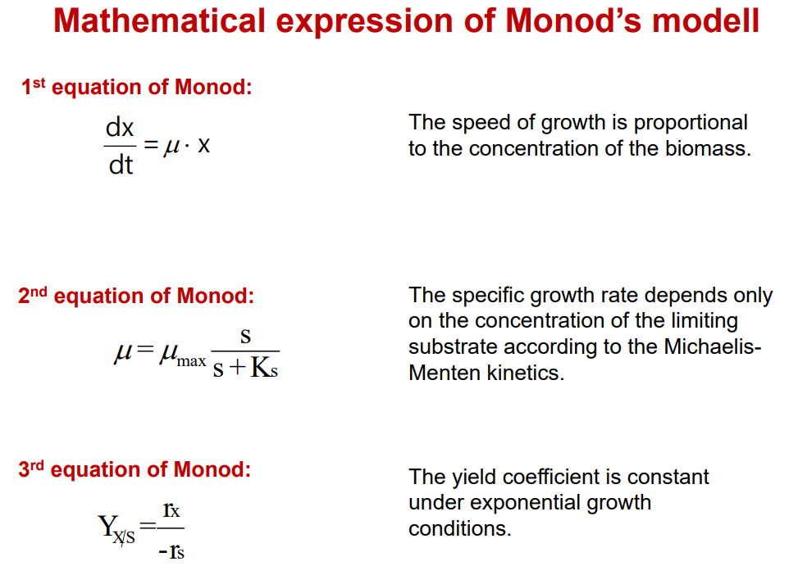
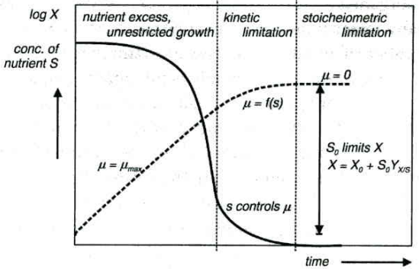
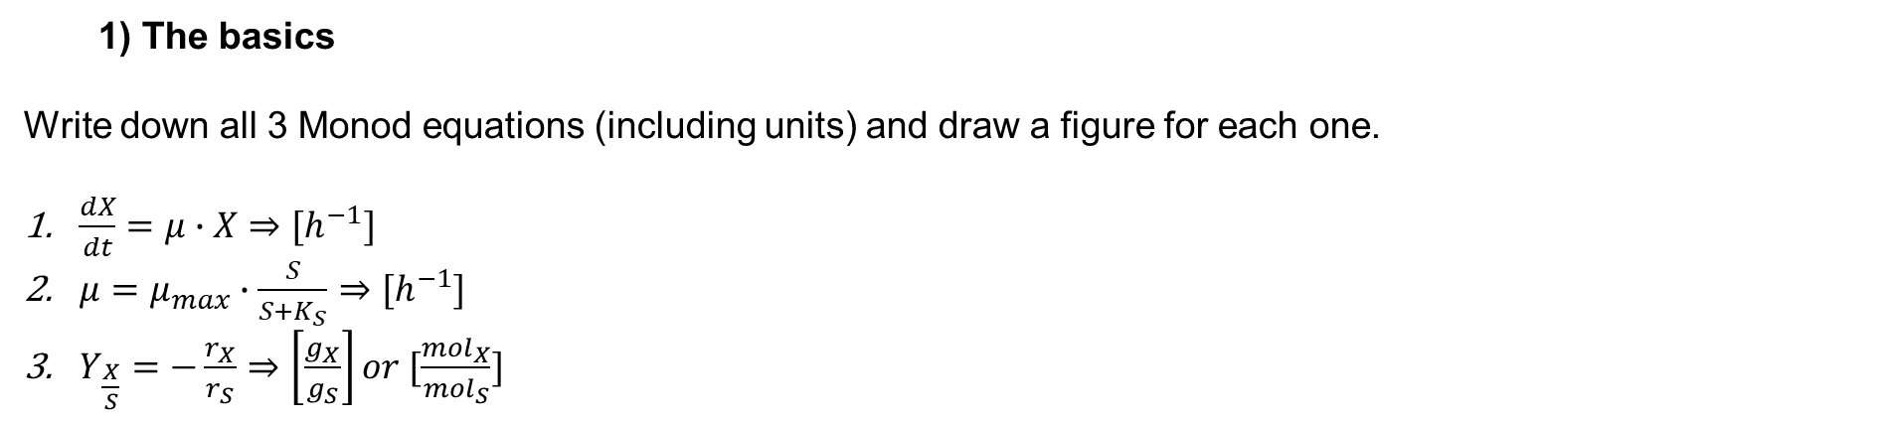
1) The basics
Write down all 3 Monod equations (including units) and draw a figure for each one.
$\frac{dX}{dt}=μ∙X⇒[h^{−1}]$
$μ=μ_{max}∙\frac{S}{S+K_{S}}⇒[h^{−1}]$
$Y_{\frac{X}{S}}=−\frac{r_{X}}{r_{S}}⇒\left[\frac{g_{X}}{g_{S}}\right]or [\frac{{mol}_{X}}{{mol}_{S}}]$

Slide 2
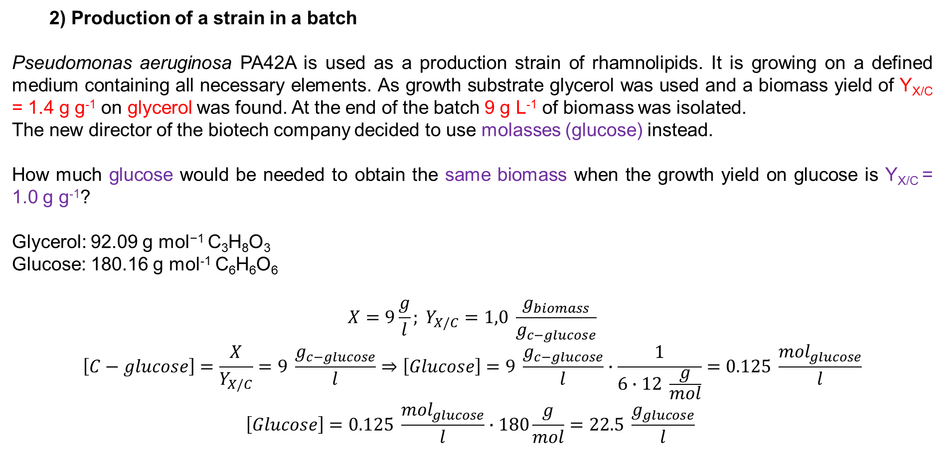
2) Production of a strain in a batch
Pseudomonas aeruginosa PA42A is used as a production strain of rhamnolipids. It is growing on a defined medium containing all necessary elements. As growth substrate glycerol was used and a biomass yield of Y_{X/C} = 1.4 g g⁻¹ on glycerol was found. At the end of the batch 9 g L⁻¹ of biomass was isolated.
The new director of the biotech company decided to use molasses (glucose) instead.
How much glucose would be needed to obtain the same biomass when the growth yield on glucose is Y_{X/C} = 1.0 g g⁻¹?
Glycerol: 92.09 g mol⁻¹ C₃H₈O₃
Glucose: 180.16 g mol⁻¹ C₆H₆O₆
$$X=9\frac{g}{l}; Y_{X/C}=1,0 \frac{g_{biomass}}{g_{c−glucose}}$$
$$\left[C−glucose\right]=\frac{X}{Y_{X/C}}=9 \frac{g_{c−glucose}}{l}⇒\left[Glucose\right]=9 \frac{g_{c−glucose}}{l}∙\frac{1}{6∙12 \frac{g}{mol}}=0.125 \frac{{mol}_{glucose}}{l}$$
$$\left[Glucose\right]=0.125 \frac{{mol}_{glucose}}{l}∙180\frac{g}{mol}=22.5 \frac{g_{glucose}}{l}$$

Slide 3
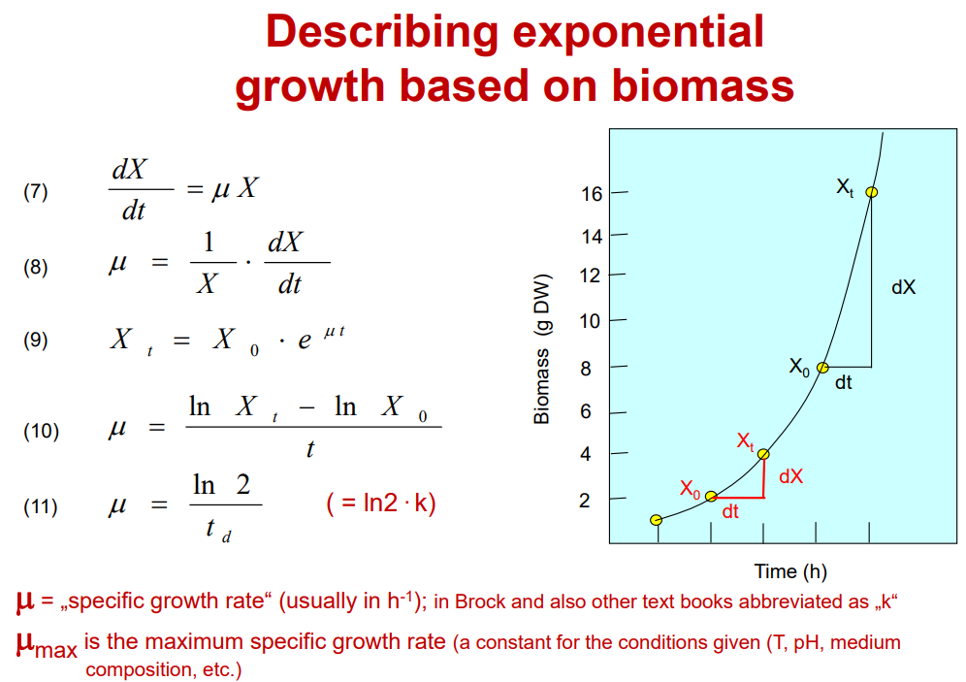
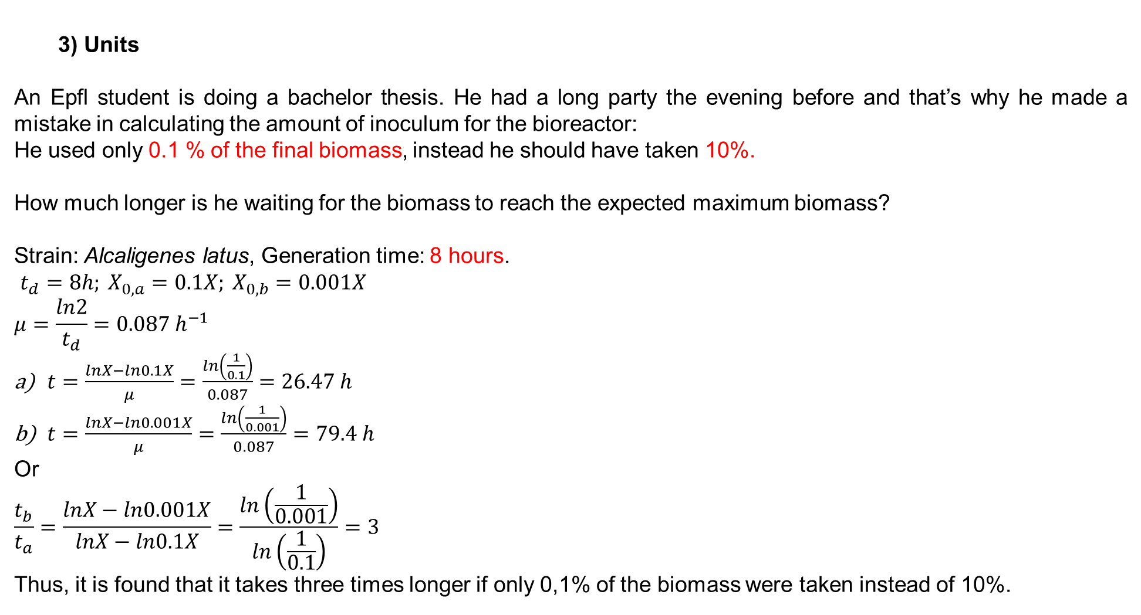
3) Units
An Epfl student is doing a bachelor thesis. He had a long party the evening before and that’s why he made a mistake in calculating the amount of inoculum for the bioreactor:
He used only 0.1 % of the final biomass, instead he should have taken 10%.
How much longer is he waiting for the biomass to reach the expected maximum biomass?
Strain: Alcaligenes latus, Generation time: 8 hours.
$t_{d}=8h; X_{0,a}=0.1X; X_{0,b}=0.001X$
$$μ=\frac{ln2}{t_{d}}=0.087 h^{−1}$$
$t=\frac{lnX−ln0.1X}{μ}=\frac{ln\left(\frac{1}{0.1}\right)}{0.087}=26.47 h$
$t=\frac{lnX−ln0.001X}{μ}=\frac{ln\left(\frac{1}{0.001}\right)}{0.087}=79.4 h$
Or
$$\frac{t_{b}}{t_{a}}=\frac{lnX−ln0.001X}{lnX−ln0.1X}=\frac{ln\left(\frac{1}{0.001}\right)}{ln\left(\frac{1}{0.1}\right)}=3$$
Thus, it is found that it takes three times longer if only 0,1% of the biomass were taken instead of 10%.

Slide 4
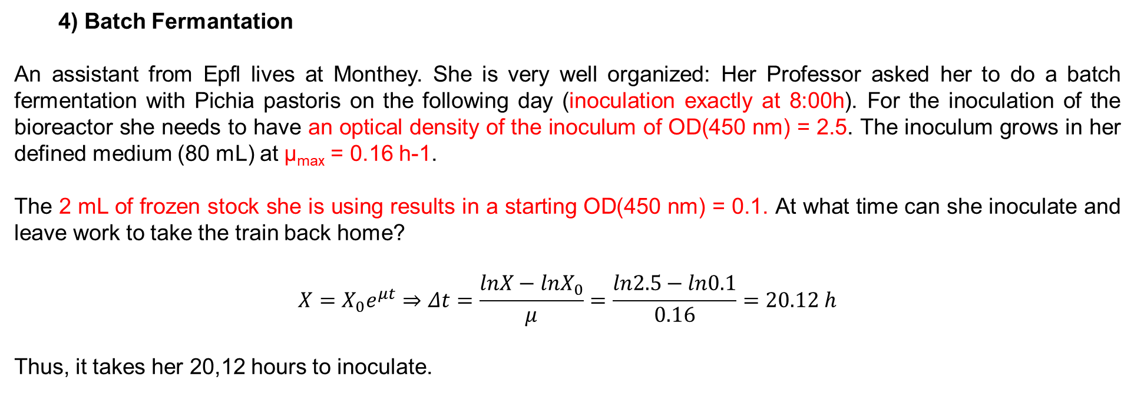
4) Batch Fermantation
An assistant from Epfl lives at Monthey. She is very well organized: Her Professor asked her to do a batch fermentation with Pichia pastoris on the following day (inoculation exactly at 8:00h). For the inoculation of the bioreactor she needs to have an optical density of the inoculum of OD(450 nm) = 2.5. The inoculum grows in her defined medium (80 mL) at μ_{max} = 0.16 h-1.
The 2 mL of frozen stock she is using results in a starting OD(450 nm) = 0.1. At what time can she inoculate and leave work to take the train back home?
$$X=X_{0}e^{μt}⇒Δt=\frac{lnX−lnX_{0}}{μ}=\frac{ln2.5−ln0.1}{0.16}=20.12 h$$
Thus, it takes her 20,12 hours to inoculate.

Slide 5
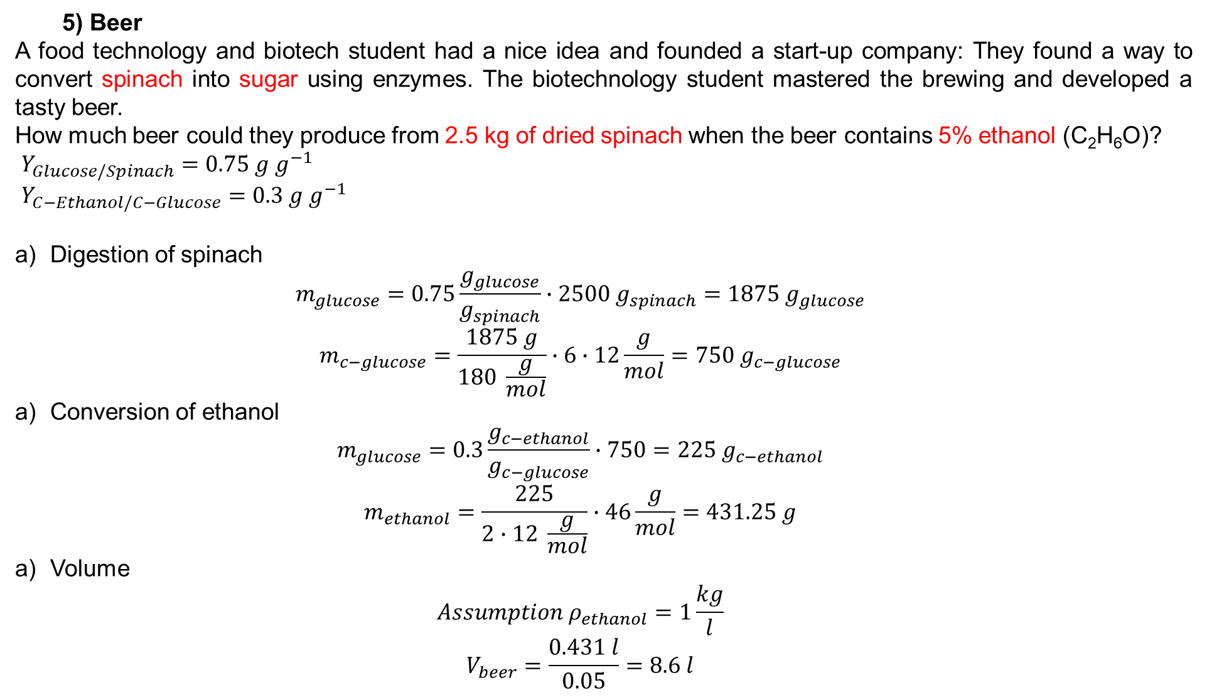
5) Beer
A food technology and biotech student had a nice idea and founded a start-up company: They found a way to convert spinach into sugar using enzymes. The biotechnology student mastered the brewing and developed a tasty beer.
How much beer could they produce from 2.5 kg of dried spinach when the beer contains 5% ethanol (C₂H₆O)?
$Y_{Glucose/Spinach}=0.75 g g^{−1}$
$Y_{C−Ethanol/C−Glucose}=0.3 g g^{−1}$
Digestion of spinach
$$m_{glucose}=0.75\frac{g_{glucose}}{g_{spinach}}∙2500{ g}_{spinach}=1875 g_{glucose}$$
$$m_{c−glucose}=\frac{1875 g}{180 \frac{g}{mol}}∙6∙12\frac{g}{mol}=750 g_{c−glucose}$$
Conversion of ethanol
$$m_{glucose}=0.3\frac{g_{c−ethanol}}{g_{c−glucose}}∙750=225 g_{c−ethanol}$$
$$m_{ethanol}=\frac{225}{2∙12 \frac{g}{mol}}∙46\frac{g}{mol}=431.25 g$$
Volume
$$Assumption ρ_{ethanol}=1\frac{kg}{l}$$
$$V_{beer}=\frac{0.431 l}{0.05}=8.6 l$$

Slide 6
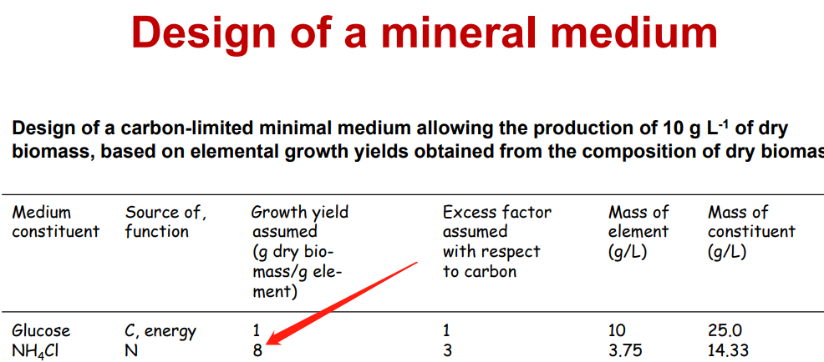
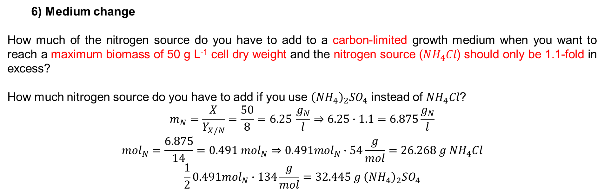
6) Medium change
How much of the nitrogen source do you have to add to a carbon-limited growth medium when you want to reach a maximum biomass of 50 g L⁻¹ cell dry weight and the nitrogen source ($NH_{4}Cl$) should only be 1.1-fold in excess?
How much nitrogen source do you have to add if you use ${\left(NH_{4}\right)}_{2}SO_{4}$ instead of $NH_{4}Cl$?
$$m_{N}=\frac{X}{Y_{X/N}}=\frac{50}{8}=6.25 \frac{g_{N}}{l}⇒6.25∙1.1=6.875\frac{g_{N}}{l}$$
$${mol}_{N}=\frac{6.875}{14}=0.491 {mol}_{N}⇒0.491{mol}_{N}∙54\frac{g}{mol}=26.268 g NH_{4}Cl$$
$$\frac{1}{2}0.491{mol}_{N}∙134\frac{g}{mol}=32.445 g {\left(NH_{4}\right)}_{2}SO_{4}$$

Slide 7
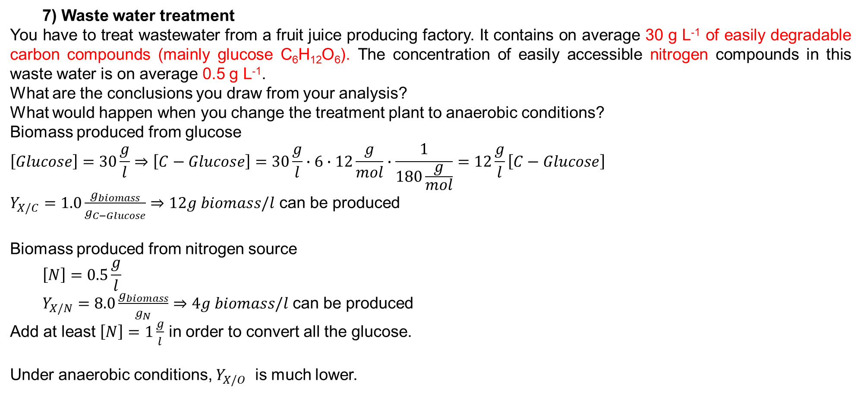
7) Waste water treatment
You have to treat wastewater from a fruit juice producing factory. It contains on average 30 g L⁻¹ of easily degradable carbon compounds (mainly glucose C₆H₁₂O₆). The concentration of easily accessible nitrogen compounds in this waste water is on average 0.5 g L⁻¹.
What are the conclusions you draw from your analysis?
What would happen when you change the treatment plant to anaerobic conditions?
Biomass produced from glucose
$$\left[Glucose\right]=30\frac{g}{l}⇒\left[C−Glucose\right]=30\frac{g}{l}∙6∙12\frac{g}{mol}∙\frac{1}{180\frac{g}{mol}}=12\frac{g}{l}\left[C−Glucose\right]$$
$Y_{X/C}=1.0\frac{g_{biomass}}{g_{C−Glucose}}⇒12g biomass/l$ can be produced
Biomass produced from nitrogen source
$$\left[N\right]=0.5\frac{g}{l}$$
$Y_{X/N}=8.0\frac{g_{biomass}}{g_{N}}⇒4g biomass/l$ can be produced
Add at least $\left[N\right]=1\frac{g}{l}$ in order to convert all the glucose.
Under anaerobic conditions, $Y_{X/O}$ is much lower.

Slide 8
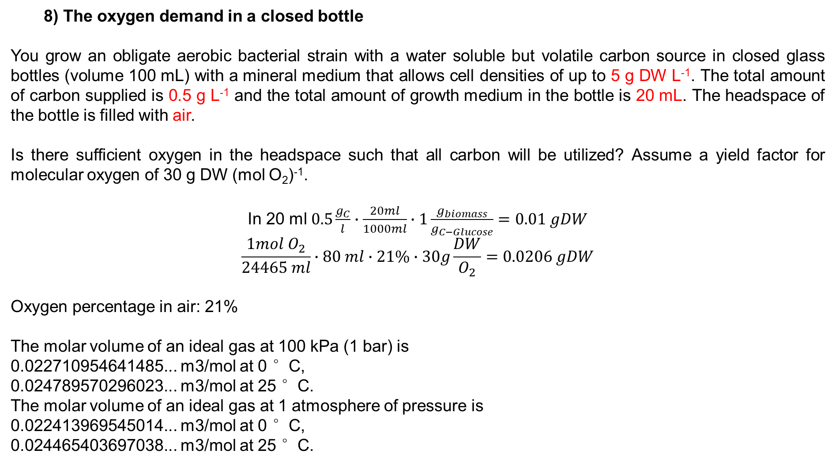
8) The oxygen demand in a closed bottle
You grow an obligate aerobic bacterial strain with a water soluble but volatile carbon source in closed glass bottles (volume 100 mL) with a mineral medium that allows cell densities of up to 5 g DW L⁻¹. The total amount of carbon supplied is 0.5 g L⁻¹ and the total amount of growth medium in the bottle is 20 mL. The headspace of the bottle is filled with air.
Is there sufficient oxygen in the headspace such that all carbon will be utilized? Assume a yield factor for molecular oxygen of 30 g DW (mol O₂)⁻¹.
In 20 ml $0.5\frac{g_{C}}{l}∙\frac{20ml}{1000ml}∙1\frac{g_{biomass}}{g_{C−Glucose}}=0.01 gDW$
$$\frac{1mol O_{2}}{24465 ml}∙80 ml∙21\%∙30g\frac{DW}{O_{2}}=0.0206 gDW$$
Oxygen percentage in air: 21%
The molar volume of an ideal gas at 100 kPa (1 bar) is
0.022710954641485... m3/mol at 0 °C,
0.024789570296023... m3/mol at 25 °C.
The molar volume of an ideal gas at 1 atmosphere of pressure is
0.022413969545014... m3/mol at 0 °C,
0.024465403697038... m3/mol at 25 °C.

